Slide 1
Exploring the Relationship Between Word Overlap and Single Word Norms when Predicting Relatedness Judgments and Retrieval
Nicholas P. Maxwell
Notes:
Today I will be briefly sharing a research project that I have been conducting on the effects of word pair relationships and judgements of these relationships on recall task performance.

Slide 2
Overview
This study examines the effects of associative, semantic, and thematic word overlap on relatedness judgments and recall

Slide 3
Judging Relatedness
Associative
How often are two words used together?
Semantic
How similar in meaning are two words?
Thematic
How closely are two words connected by an overall theme?
Notes:
The present study has participants making judgements of how related pairs of words are based on the following three measures of relatedness:
Associative
Semantic
Thematic

Slide 4
Measuring Pair Overlap
Associative
Forward Strength (FSG), which is the probability of responding to a cue word with a particular target
Semantic
Calculates a cosine (COS) value representing the amount of feature overlap between two concepts.
Thematic
Latent Semantic Analysis (LSA)
Notes:
So how did we measures these relationships?
We used Forward Strength as an indicator of associative relatedness. This is the probability that a cue word will elicit a particular target word. For example, if the pair MOUSE-CHEESE has an fsg of .72, then the cue word MOUSE will elicit the response “CHEESE” approximately 72% of the time.
Semantic relatedness is being measured with Cosine. A cosine value represents the amount of feature overlap between two concepts. The higher the COS between two words, the more similar their dictionary definitions are to one another. Expanding upon our earlier example, Mouse and Cheese have a cosine of only .01, suggesting zero feature overlap.
Thematic relatedness is being measured with Latent Semantic Analysis or LSA. LSA calculates a value based on the co-occurrences of words together in a document with the overall meaning of a document. This value can be viewed as a middle ground between association and semantics.

Slide 5
Judgments of Associative Memory
Manipulated JOL task that investigates perception of word associations
Maki (2007a, 2007b)
Participants are asked to estimate the number of people out of 100 who would respond to the cue with the given target
These ratings mimic the free association process used to create word association norms

Slide 6
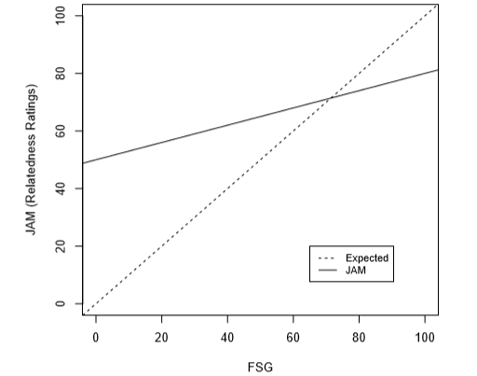
JAM Function
The JAM Function
Characterized by a high intercept and shallow slope
One goal of the pilot study was to replicate this function and then extend it to semantic and thematic judgments

Slide 7
Goals of the Pilot Study
Expand previous JAM findings to include semantic and thematic judgments
Examine interactions between IVs for recall.
Examine interactions between IVs for judgments.
Test whether judgment slopes obtained in hypothesis one are predictive of recall.

Slide 8
Participants and Stimuli
112 Participants were recruited from Amazon’s Mechanical Turk
Participants completed the study online via Qualtrics
63 Word pairs of varying associative, semantic, and thematic strengths were created by pulling word pairs from three normed databases.
Notes:
For this study, we recruited 100 participants from Amazon’s mechanical turk. The study was conducted online via Qualtrics.
63 word pairs were of varying associative, semantic, and thematic strengths were created from 3 normed databases.

Slide 9
Overall Design
Three Judgement Blocks
Distractor Task
Cued Recall Task
Notes:
The study was divided into three sections:
Section one consisted of three blocks where participants were presented with pairs of words and were asked to make judgements of how related they perceived the words in each pair to be. Participants then completed the next section in which they spent two minutes alphabetizing lists of states. This was followed by a cued recall task.

Slide 10
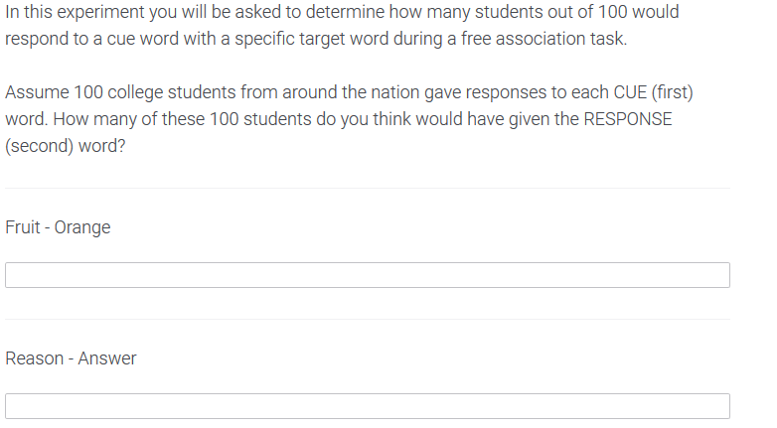
Judgement Blocks
21 word pairs per block
The instructions at the start of each block explain one of the three types of relationships (Associative, Semantic, or Thematic), and the instructions change with each block.
Judgments made on a scale of 0 to 100, with 0 indicating no relationship and 100 indicating a perfect relationship
Notes:
Three Judgment blocks, 21 words per block (7 low strength, 7 medium strength, 7 high strength). At the beginning of each block, participants receive instructions explaining associative, semantic, or thematic relationships and are asked to judge each word pair’s relatedness based on that criteria. These judgements are made on a scale of 0 to 100.
The picture is an example of the instructions participants receive for the associative judgment block.
There are three different versions of the study that rotate which instructions appear with which block and counter balance the order of the blocks. The end result is that each word pair receives judgements based on all three criteria.

Slide 11
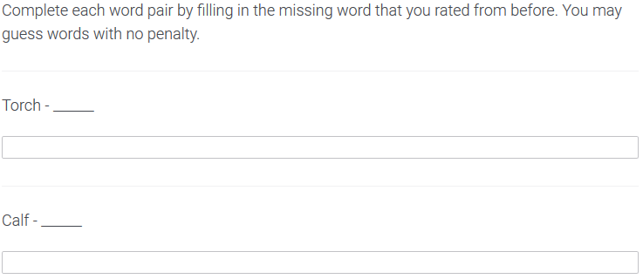
Recall Phase
Participants are presented with the first word from each of the pairs they previously judged and are asked to recall the target word it was paired with.
Notes:
The final section of the study is a cued recall phase. In this section participants are presented with each of the 63 cue words from the judgement blocks and are asked to respond with the correct target word. The cue words appear in a randomized order and participants are allowed to take as long as needed to complete this section.

Slide 12
Study Design
IVs
DVs
Judgment type (control)
Associative Strength
Semantic Strength
Thematic Strength
Interactions
Recall Score
Judgment Value
Notes:
The data was analyzed with a Multi-Level Model and Logistic Regression.
List IV’s and DV’s

Slide 13
Analysis
Multi-level modeling was used to analyze the data
Each participant’s individual judgment and recall ratings are treated as separate data points.
Missing data points were coded as NA, and one judgment score was removed for being out of range.
Participants who did not follow instructions were also removed (i.e., responding with words for item judgments)
In total, 787 data points were excluded, leading to 6,269 observations taken from 105 participants.

Slide 14
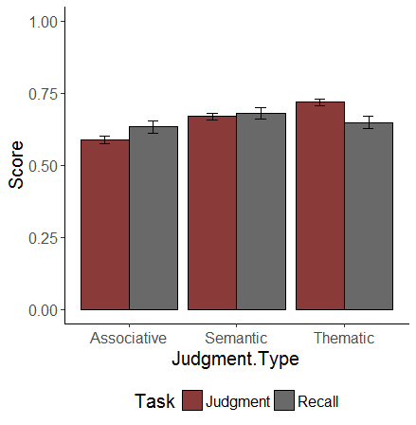
Mean Judgment and Recall Scores
Notes:
The type of judgement being made did not effect recall. The percent of word pairs correctly recalled hovered around 60% for each of the three types of judgements. However, the type of judgement being made did have an effect on the relatedness values that participants assigned. Participants were more likely to rate the thematic relationships as being more similar. This may in part be due to the fact that thematics can be viewed as a combination of association and semantics, meaning that there is more information encoded in the word pairs for participants to work with.

Slide 15
MLM Results – Recall
Main Effects Table
IV | β | Std. Error | t | p
FSG | 0.65 | 0.04 | 14.68 | < 0.001
COS | 0.18 | 0.03 | 5.54 | < 0.001
LSA | -0.06 | 0.04 | -1.60 | 0.11
Notes:
These results show that both FSG and COS strength significantly predict performance on the recall task. The judged value that participants assigned to the word pairs was also a significant predictor of recall performance.
FSG is the strongest predictor of recall, followed Judged Value and COS. LSA is not a significant predictor. These results suggest that how associatively related two words are plays a strong role in how likely an individual is to remember them.

Slide 16
MLM Results – Judgments
Main Effects Table
IV | β | Std. Error | z | p
FSG | 0.27 | 0.03 | 9.42 | < .001
COS | -0.10 | 0.02 | -6.08 | < .001
LSA | 0.09 | 0.02 | 4.20 | < .001
Notes:
These results show that both FSG and COS strength significantly predict performance on the recall task. The judged value that participants assigned to the word pairs was also a significant predictor of recall performance.
FSG is the strongest predictor of recall, followed Judged Value and COS. LSA is not a significant predictor. These results suggest that how associatively related two words are plays a strong role in how likely an individual is to remember them.

Slide 17
Three-Way Interactions
Task | β | Standard Error | Test Statistic | p
Recall | 24.57 | 5.85 | 4.20 | < .001
Judgment | 3.32 | 0.49 | 6.791 | <.001

Slide 18
Moderation Analyses
Simple Slopes: Recall
Simple Slopes: Judgments

Slide 19
The Current Study
The present study seeks to examine the influence of single word norms on recall and judgments

Slide 20
Single Word Norms
Rated Properties:
Age of Acquisition
Imageability
Concreteness
Valence
Familiarity
Item Connections:
Cue and Target Set Sizes
Feature Set Size
Cosine Connectedness
Orthographic and Phonographic neighborhoods
Base Word Norms (Lexical Information):
Length
Frequency
Phonemes
Morphemes
Syllables

Slide 21
Method
Same general method as the pilot study
Recruiting 200 participants via Mechanical Turk

Slide 22
Analysis
Data will be analyzed through multilevel modeling
Single word norms will be grouped by type and entered into the analysis in a series of steps in the following order:
Base word norms
Word ratings
Item connections
Finally, network norms will be analyzed.

Slide 23
Goals of the Present Study
Replicate interaction findings from the pilot study with a new stimuli set
Expand upon these findings by including single word norms in the analysis
Determine which single word norms have the greatest impact on judgment and recall
Further assess the impact of network connections after controlling for single word norms

